Slide 1
Evidence & the Determinants of Health:
SES & Inequalities
Sharon Yanicki
Feb. 25 2016

Slide 2
Overview
Social class & differences in health status
  Social inequalities & Income
  Definitions of terms
Explanations for the social gradient
  Materialist & Neo-materialist
  Cultural/Behavioural
  Psychosocial
Unnatural Causes (*DVD on reserve at the library for 1 week)
  Discussion of examples
  Applying sociological perspectives to explain health inequalities

Slide 3
Learning Objectives
By the end of class you will be able to:
Describe and define the following sociological concepts:
  Social gradient
  Income gap
  Differential exposure hypothesis
  Differential vulnerability hypothesis
  Differential consequences
  Describe three main explanations for health inequalities
  Describe the social gradient in population health.
  Apply sociological perspectives to explain health inequities in a case example.

Slide 4
Reflecting on SDOH & Good Health
In contrast to the social determinants of ill health in populations:
“the determinants of good health must include measures of the salutary factors that help to keep people healthy…” (Segall & Fries, 2011, p. 113)

Slide 5
General Determinants of Health & Wellness
Segall & Fries p. 115 Adding to the Model
Marmot (2006) Labonte (1993)
Autonomy Risk Conditions
Salutogentic Pathogenic
Major Determinants
Salutary Factors Risk Factors
Sense of Coherence Microorganisms
Coping Skills Viruses
Supportive social Infectious Disease
environment Chronic Disease
Behavioural Dimensions
Health Maintenance Illness Avoidance
Health resource Preventive
management medical care
Enhanced self-care Risk reduction
capacity
Good Health
Ill Health
Notes:
See the article suggested by Group 6 in today’s facilitated discussion - Courtwright (2008) Health disparities and autonomy for a discussion on Marmot’s arguments for autonomy (and social participation) as a determinant of good health and a lack of autonomy (and social isolation) as a cause of stress and chronic neuroendocrine activation.

Slide 6
i<Clicker Question #1
Segall & Fries’ model of the “determinants of good health and ill health” includes which of the following?
the pathogenic approach – a focus on risk factors and illness avoidance
the salutogenic approach – a focus on psychosocial aspects of health status and health-protective behaviours.
major determinants of health
behavioural dimensions
all of the above

Slide 7
Definitions: Differences in Health
What is the difference in meaning between the following terms?
Health Disparities
(descriptive)
Health Inequality
(measurable)
Health Inequities
(normative)
Definitions of Terms
Differences in health
Unequal distributions of health between groups, populations and countries
“Avoidable health inequalities that are unnecessary and unjust” (Schofield, 2007, cited in Segall & Fries, p. 143)
Critical social theory focuses here.
(Habermas, 1983).)
Notes:
Descriptive = describes observed differences in groups, populations and countries
Measureable = a measurable difference
Normative = an unfair and unjust difference
Critical social theory suggests that we should seek to modify the conditions in society that create unjust, unfair and modifiable differences in health.

Slide 8
Socio-economic Status
“SES = measured by “income, education or occupation”
Lower socioeconomic status is associated with:
  Higher rates of morbidity and mortality
  SES is strongly related to population health regardless of the measure of SES or health used (Segall & Fries, p. 121-126)

Slide 9
What do we know about SES & Health?
Marmot et al 1997, cited in Segall & Fries, p. 126-128)
SES & Health
  The Black Report
  The Whitehall Study in England (Marmott et al, 1997, cited in Segall & Fries, p. 127- 128)
Social Gradient
  “a graded association between the indicators of socioeconomic status (SES) and population health”(p. 127) (higher status = better health at each step in the social hierarchy)

Slide 10
SES & Health
Clarke, 2012, p. 96
Income
Health & Wellbeing

Slide 11
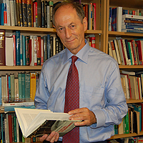
Socioeconomic Class
(Marmot et al, 1987)
Whitehall I & II Studies
“Nearly regardless of cause of death, persons in the lower ‘class’ occupations died younger than persons in the middle classes, and those in the middle classes died younger than persons in the top class” (Marmot, 2000, cited in Freund, McGuire & Podhurst, 2003, p 40).
Sir Michael Marmot
Examined the causes of death for subjects followed since 1985.
A stepwise Social gradient was identified across groups by social class (income, occupation & education).
Notes:
The reasons for the social gradient have been hotly debated.
Possible reasons: lower class may experience humiliation and disrespect
Race and ethnic inequality as intervening variable
Psychosocial factors such as insecurity, stress, or a sense of helplessness or lack of control?
Differences in access to health services and resources

Slide 12
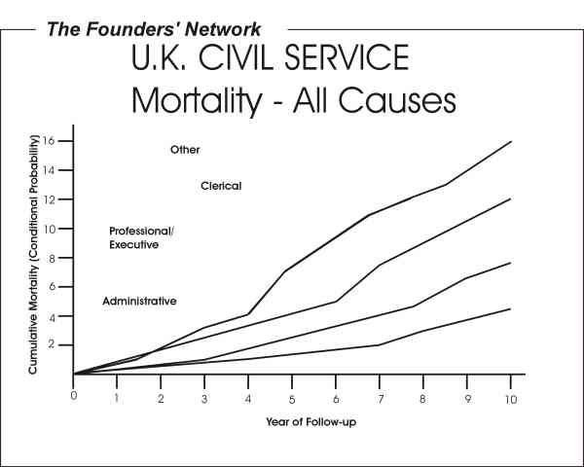
The Whitehall Study
Marmott et al, 1987
Other
Clerical
Professional/
Executive
Administrative
Notes:
Marmot, M. G.; Rose, G.; Shipley, M.; Hamilton, P. J. (1978). "Employment grade and coronary heart disease in British civil servants". Journal of Epidemiology and Community Health 32 (4): 244–249. doi:10.1136/jech.32.4.244. PMC 1060958. PMID 744814

Slide 13
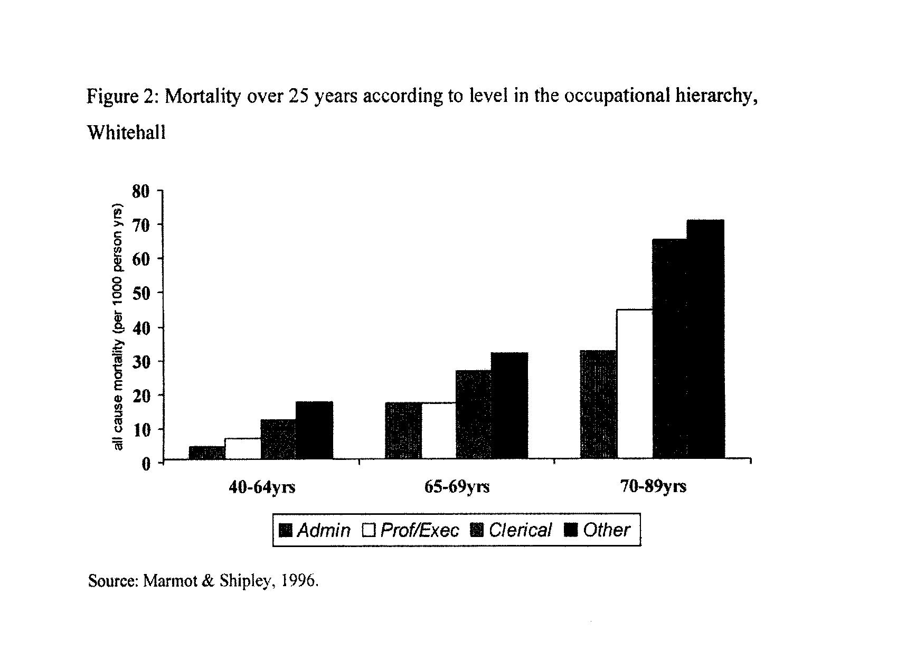
Whitehall II
Notes:
Marmot, M. G.; Davey Smith, G.; Stansfield, S.; et al. (1991). "Health Inequalities among British civil servants: the Whitehall II study". Lancet 337 (8754): 1387–1393. doi:10.1016/0140-6736(91)93068-K. PMID 1674771

Slide 14
i<Clicker Question # 2
The Whitehall Study is best known for:
identifying a social gradient in rates of mortality and morbidity by social class
identifying the income gap
identifying equal distributions of health by occupation and age
Identifying equal distributions of health by education
all of the above

Slide 15
Effects of SES on Health
Segall & Chappell, 2000, p. 177
Socioeconomic Status (SES)
Income
Education
Employment
Direct Effects
Health Effects
Perceived Health
Morbidity
Mortality
Indirect Effects
Lifestyle
Housing
Nutrition
Exercise/Recreation

Slide 16
Direct versus Indirect Effects
Can you think of an example of how living on a low income could have both direct and indirect effects on health?
Brainstorming

Slide 17
Hypothetical Model – SES & Individual Health
Differing access to Resources, Opportunities & Power Adapted from Clarke 2012 p. 96
Material Resources Lifestyles Family/Community
Housing Smoking Stability/Integration
Food Drinking Supportive relations
Clean Water Exercise Decision-making
Access to HC Resources Sexual activity Privacy
Standard of Living Risk-Taking
Psychosocial Resources
Stable secure employment
Supportive work relationships
Education
Coping Abilities
Sense of Coherence
Social Readjustment
Emotional Stability
Sense of Efficacy
Sense of coherence = The extent to which one has a feeling of confidence in one’s environment as being predictable and that things will work out as well as can be expected (Antonovsky,1979).

Slide 18
Differential Exposure Hypothesis versus
Differential Vulnerability Hypothesis
Segall & Fries, p. 136
Differential Exposure
Material conditions
> Exposure
SES & Social class gradient
Stressors
Health
Differential access to resources and differing life experiences
Differential Vulnerability
Stressors
Health
SES & Social class gradient
Socialization & Risky Behaviour

Slide 19
DVD: Unnatural Causes
http://www.unnaturalcauses.org/episode_descriptions.php?page=4
See on-line resources

Slide 20
Explaining the Social Gradient & Health inequalities Segall & Fries, p. 134 – 139; Raphael, 2010
Cultural/Behavioural Explanations
Differential Vulnerability Hypothesis
Health in America – Unnatural Causes
Materialist/Structural Explanations:
Materialist
Neo-Materialist
Psychosocial Comparison
Behavioural risk factors account for a small proportion of variation in morbidity & mortality
The weight of evidence suggests that socioeconomic factors play the major role in explaining health disparities.
Differing views
Evidence from population health surveillance

Slide 21
Materialist Explanations
Segal & Fries, p.134-135; Bartley, 2003, cited in Raphael, 2010
Conditions of living
Wealth of Nations (GDP)
SES
Differential exposure hypothesis
- Diabetes – Genes or Environment
Differential exposure to risk conditions leads to
material deprivation &
psychosocial stressors (finances, crime, social isolation)
Influences the quality of individual development, family life, interaction and community environments
Material Disadvantage
Responses to deprivation & stress
Notes:
Differential exposure influences the quality of development, family life, interaction and community environments
In a study of over 200 Canadian studies of income and health, materialist and neo-materialist explanations were the most common (studies between 1995-2002). (Raphael, 2010).

Slide 22
Example: The Environment, Pollution & SES
Global Context
How is Location associated with social class?
One of the world’s worst industrial disasters occurred in Bhopal, India, when a Union Carbide plant, explosion released 40 tons of lethal methyl isocyanate gas
6,000 people were killed in the surrounding slums (Clarke, p. 73)
Differential Exposure
Poor communities are more likely be victims of “corporate pollution” (Krieger & Fee 1994, cited in Freund, McGuire & Podhurst, 2003, p. 73)

Slide 23
Neo-materialist Explanation
Segal & Fries, p.134-135
Differing access to resources & support
Differing life experiences
lead to the adoption of health threatening behaviours
(Brunner & Marmot, 2006)
Sociopolitical context & policies
More egalitarian distributions of resources (<income gap) and >public infrastructure lead to better population health
(Raphael, et al, 2005, cited in
Segall & Fries, 134-135
Conditions of living & social infrastructure
The Gila Crossing School Programs (Cultural Renewal, Changing conditions of living & Infastructure)
Social Inequality causes health inequality
Egalitarian policies promote population health

Slide 24
Example:
Working Conditions & Social Class
Canada
How does social class impact working conditions?
  Factory worker versus white collar worker
  Sense of control
  Work environments
Workers self-reports of health problems are “often ignored or invalidated” (Freund, McGuire & Podhurst, p. 76) –
  Minor’s asthma – layman’s term
  Black lung – it took years to find causal evidence
  Why have governments been slow to develop policy & legislative protection for workers?
  Sociopolitical & Structural Barriers -
  Can you think of a recent example in Canada?
Notes:
Link: Investment in protection for workers is limited by Capitalism and Political Ideology

Slide 25
Psychosocial Explanation
Segal & Fries, p. 137- 139; Wilkinson & Pickett, 2010
Hierarchy & Social Distance
Individual perceived status
Racism and Social Distance
Unnatural Causes clip
How does racism impact health – example: pregnancy outcomes?
= Lower standing in a social hierarchy leads to shame, stress and poor health (Kawachi & Kennedy, 2002)
= Community-level comparison and a widening gap weakens social trust and public infrastructure
Social Comparison
Individual & Community
Notes:
See handout – The Determinants of Good health and Ill Health – Figure 4.5 on p. 115 – Segall & Fries.

Slide 26
Psychosocial aspects of social status Segall & Fries, p. 114-115
Sense of coherence
Effective coping skills
Social support
Supportive social environments
Self-care capacity & self-health management
Antonovsky (1979, cited in Segall & Fries p. 80-81)
See PHAC, Determinants of Health
Segall & Fries, p. 250-251
Salutary factors
Mediate Risk Conditions & Stress
Notes:
Sense of Coherence = an orientation to life – a predominant sense of confidence that ones’ internal and external environment can be predicted and things will work out as well as can be expected.
Comprehensibility
Manageability
Meaningfulness
Social support and a supportive environment act to buffer stress

Slide 27
I<Clicker Question #3
One of the following explanations argues that it is not only differential access to social and economic resources and differential life experiences of the individual but also the social and political investment in infrastructure that leads to health inequalities in populations:
Materialist
Neo-materialist
Biology/genetics
Psychosocial
Cultural/Behavioural
(Raphael et al 2005, cited in Segall & Fries, p. 135)

Slide 28
What do we know?
SES inequalities & population health status
Wilkinson & Marmot, 2003, cited in Segall & Fries, p. 138-143
Explanations for the social gradient…
Structural and personal determinants…
Material conditions and social meaning matter
Social inequalities are increasing.
Health inequities are matters of social policy.
Need to be integrated
Interact to create collective impacts
Both quantitative and qualitative data are required.
Health inequities occur around the globe.
Health inequities are modifiable.

Slide 29
Health Inequalities & Public Policies
Bryant, 2010; Coburn, 2010
Public Policies
Political economy perspective
“Public policy is a course of action or inaction chose by public authorities to address a given problem or interrelated set of problems” (Bryant, 2010, p. 239).
Political Economy – “focuses on the links between health and the economic, political and social life of people in different groups, classes, regions and societies” (Coburn, 2010, p. 65).

Slide 30
Hypothetical Model of the Contribution of Equity to Population Health Adapted from Clarke 2012, p. 97
Equity in society
(income, ethnicity, gender, sexual orientation,
ability & religious affiliation)
Equity in decision-making & choice
Equitable access to: Health
  material resources of
  healthcare resources Population
  political power (family, local and national levels)
  education
  meaning making (world views, religion)
Notes:
We could also say that inequalities in these areas leads to health inequalities.
Consider the presence or absence of equity in the case examples from Unnatural Causes in the next section.

Slide 31
Discussion Questions
Based on the video clips from Unnatural Causes:
1. What factors lead to the high rates of Diabetes in two First Nations Tribes in the US?
a) Were personal or structural factors most important?
b) How did government policies impact
traditional farming practices,
the physical and social environments,
infrastructure and sustainable livelihoods?
2. Given an example of each of the following explanations for health disparities from the video clips:
materialist
neo-materialist
psychosocial

Slide 32
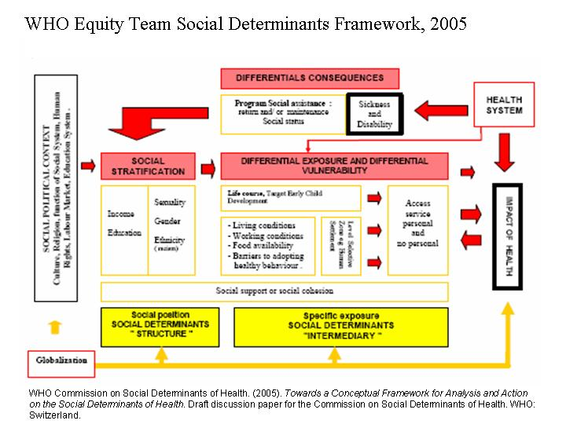
http://www.courseweb.uottawa.ca/pop8910/Outline/Models/WHO%20Equity%20Model.htm

Slide 33
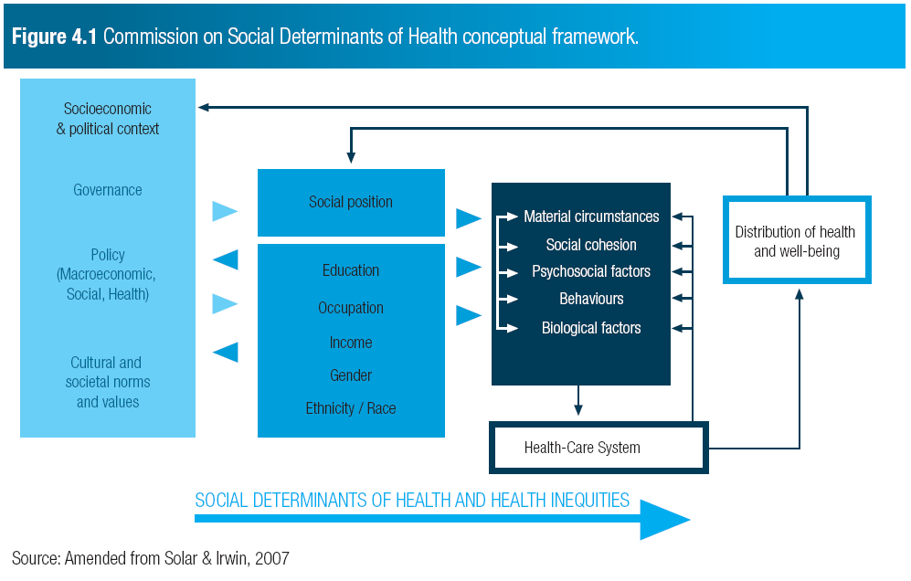

Slide 34
Base Group Activity
Review the two conceptual frameworks from the WHO Commission on SDOH (2005, 2008).
1. Identify some of the key terms from today’s class and give an example of each of these:
a) Differential Exposure Groups 1, 2 & 3
b) Differential Vulnerability Groups 4 & 5
c) Differential Consequences Groups 6, 7 & 8
2. Describe a health inequality from the video clips from one of the following sociological perspectives:
a) Symbolic Interactionism Groups 5 & 6
b) Conflict theory Groups 3 & 4
d) Structural Functionalism Group 5
d) Political Economy Group 6

Slide 35
i<Clicker Question #4
Unnatural Causes Case Example:
Terrol Dew Johnsons said: “A lot of people in my family and around me have Diabetes. Somehow, I always thought well, ok, that’s just part of growing up.” Terrol believes Diabetes just runs in his family and tribe.
From a Sociological Imagination perspective Diabetes has:
become understood as a private trouble rather than a social issue
become understood as disease that has been socially constructed by living in risk conditions
is understood as a professional construct (a disease defined by the medical profession)
is understood as a gendered experience
all of the above

Slide 36
References
Bryant, T. (2010). Politics, public policy, and health inequalities.
In T. Bryant, D. Raphael & M. Rioux (Eds.), Staying alive:
Critical perspectives on health, illness and health care (2nd
ed., pp. 239-266). Toronto: Canadian Scholars Press.
California Newsreel & Vital Pictures Inc. (2008). Unnatural
Causes: Is inequality making us sick? Available: http://www.unnaturalcauses.org/video_clips.php
Clarke, J. N. (2012). Health, illness, and medicine in Canada (6th
ed.). Don Mills: Oxford University Press.
Coburn, D. (2010). Health and health care: A political economy
perspective. In T. Bryant, D. Raphael & M. Rioux (Eds.),
Staying alive: Critical perspectives on health, illness and
health care (2nd ed., pp. 65-92). Toronto: Canadian
Scholars Press.

Slide 37
References
Freund, E. S., McGuire, M. B., & Podhurst, L. S. (2003). Who
becomes sick, injured, or dies? Health, illness and the social
body: A critical sociology (4th ed., pp. 10-44). Upper Saddle
River, New Jersey: Prentice Hall.
WHO Commission on Social Determinants of Health (2005).
Towards a conceptual framework for analysis and action
on the social determinants of health. Draft discussion paper
for the Commission on Social Determinants of Health.
Geneva: World Health Organization.
WHO Commission on Social Determinants of Health. (2008,
28/08/08). Closing the gap in a generation: Health equity
through action on the social determinants of health
Retrieved 04/09/2008, 2008, from http://whqlibdoc.who.int/hq/2008/WHO_IER_CSDH_08.1_eng.pdf

